Slide 1

Project 3 – Ski Tracker
Laura Dudley, Peter Hoagland, Matt Jackson
Jan 22, 2024

Slide 2
Overview
Overview
This project is a shout out to all the powder hounds out there. Our target user is anyone who has ever planned a ski trip and found themself on a mountain without any snow. We wanted to create a resource that would help ski and snowboard enthusiasts plan better trips.
Mountain excursions are expensive and can be present logistical challenges. Plane reservations, lift tickets, hotel / AirBnB accommodations – all can present obstacles for would be snow athletes. While most dedicated riders can stomach the prices and planning, the trip can take a dramatic downturn if one element doesn’t fall into place: snow. Our goal is to deliver more snowy days on the hill.

Slide 3
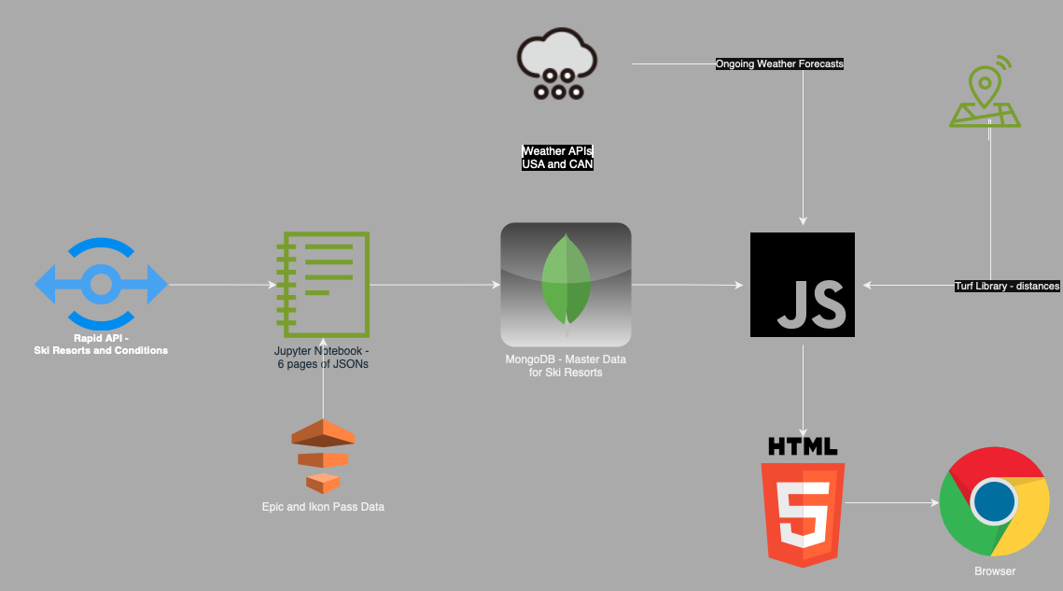
Data Flow Diagram

Slide 4
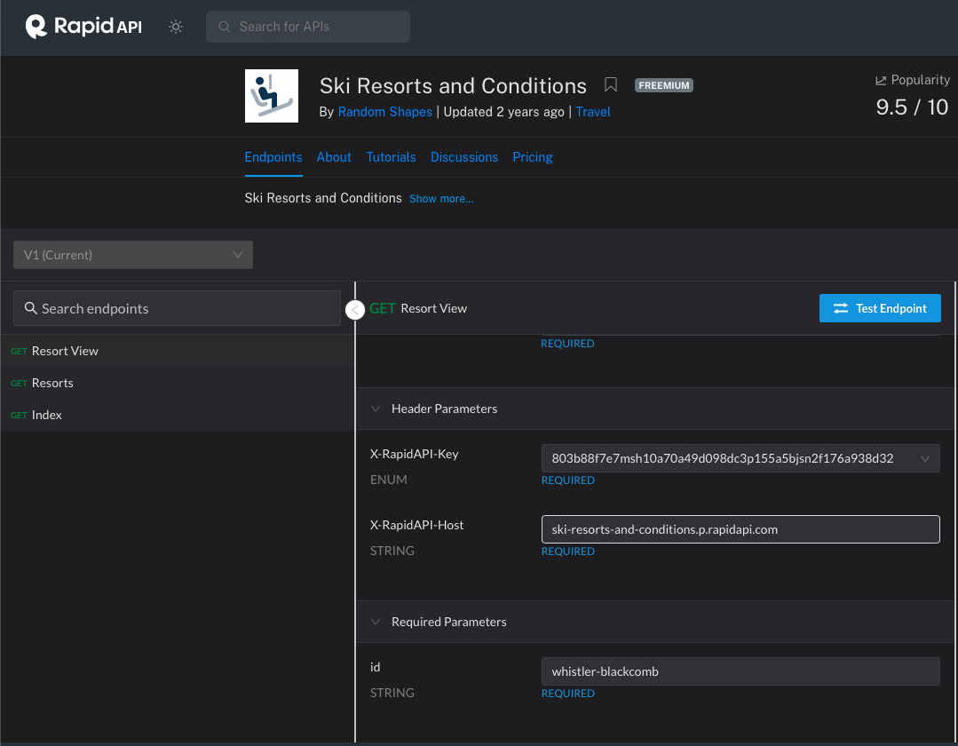
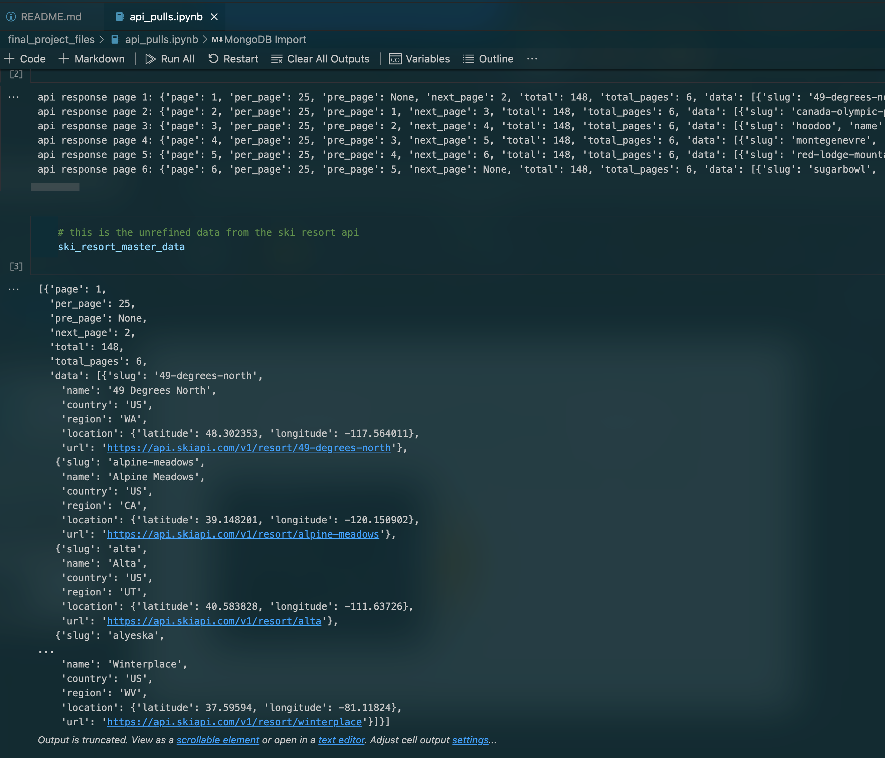
Initial API Pull → ipynb File

Slide 5
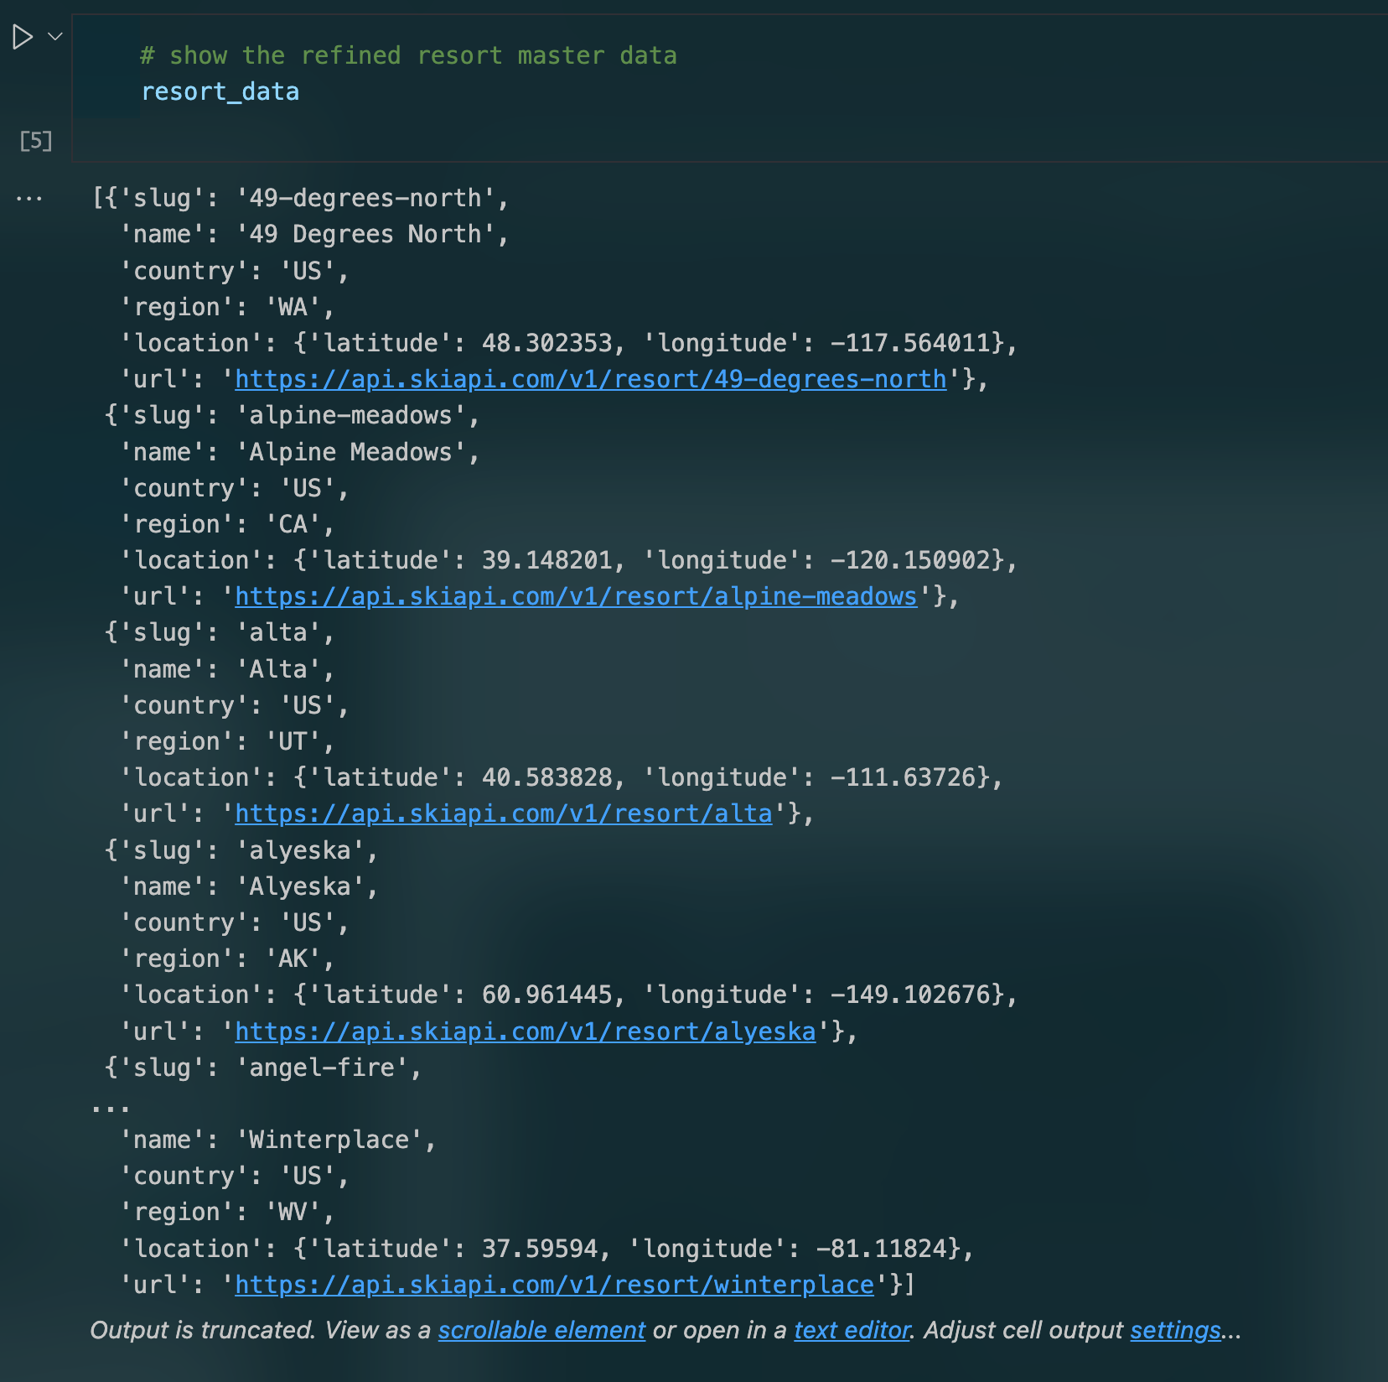
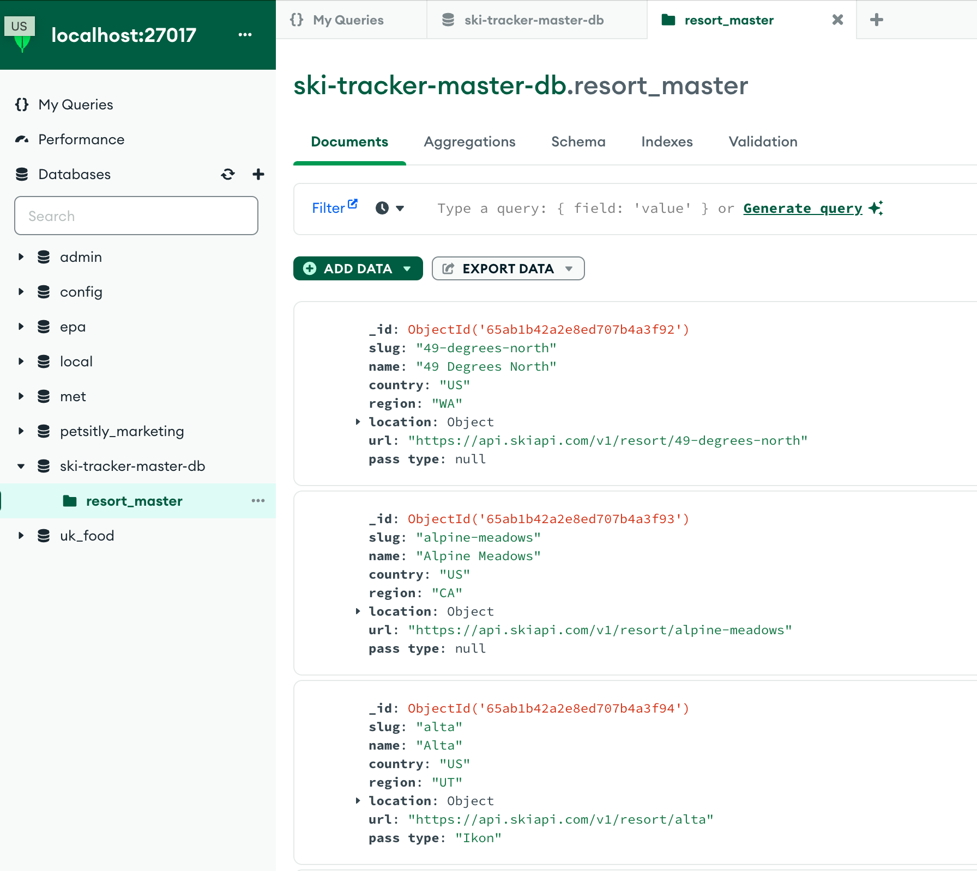
ipynb File → MongoDB

Slide 6
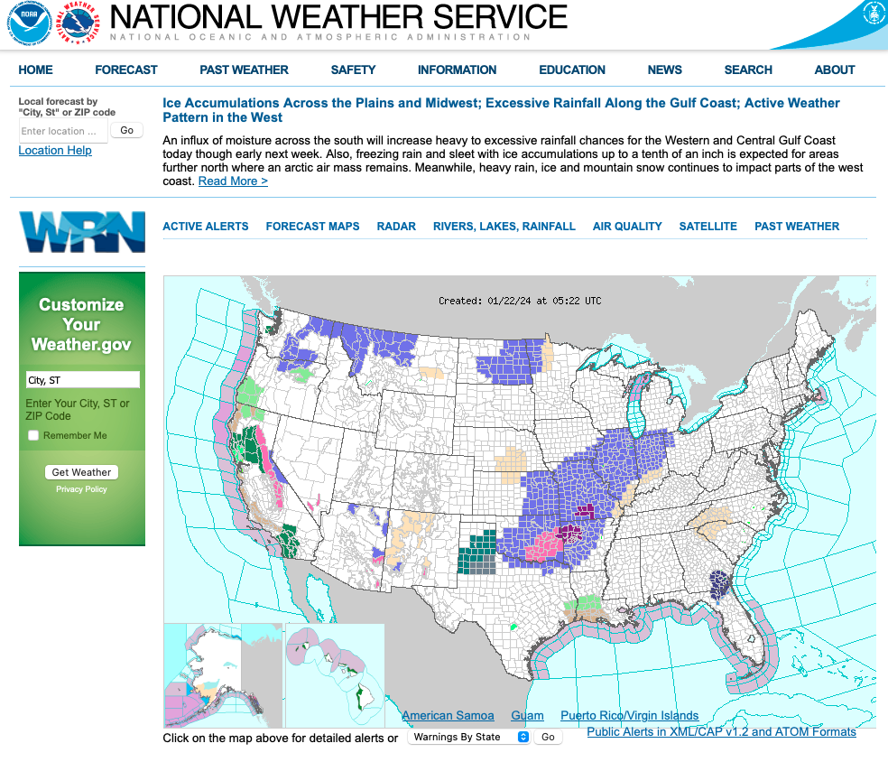
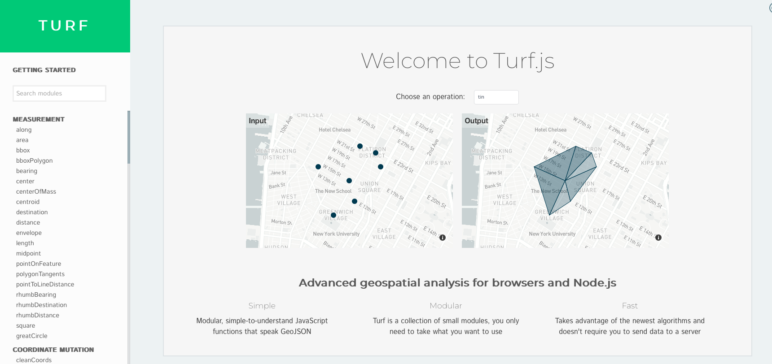
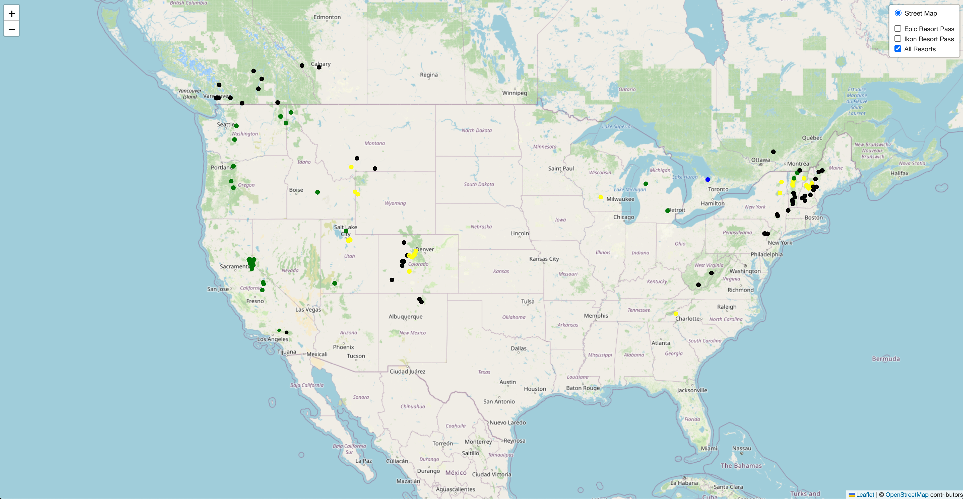
JavaScript Imports

Slide 7
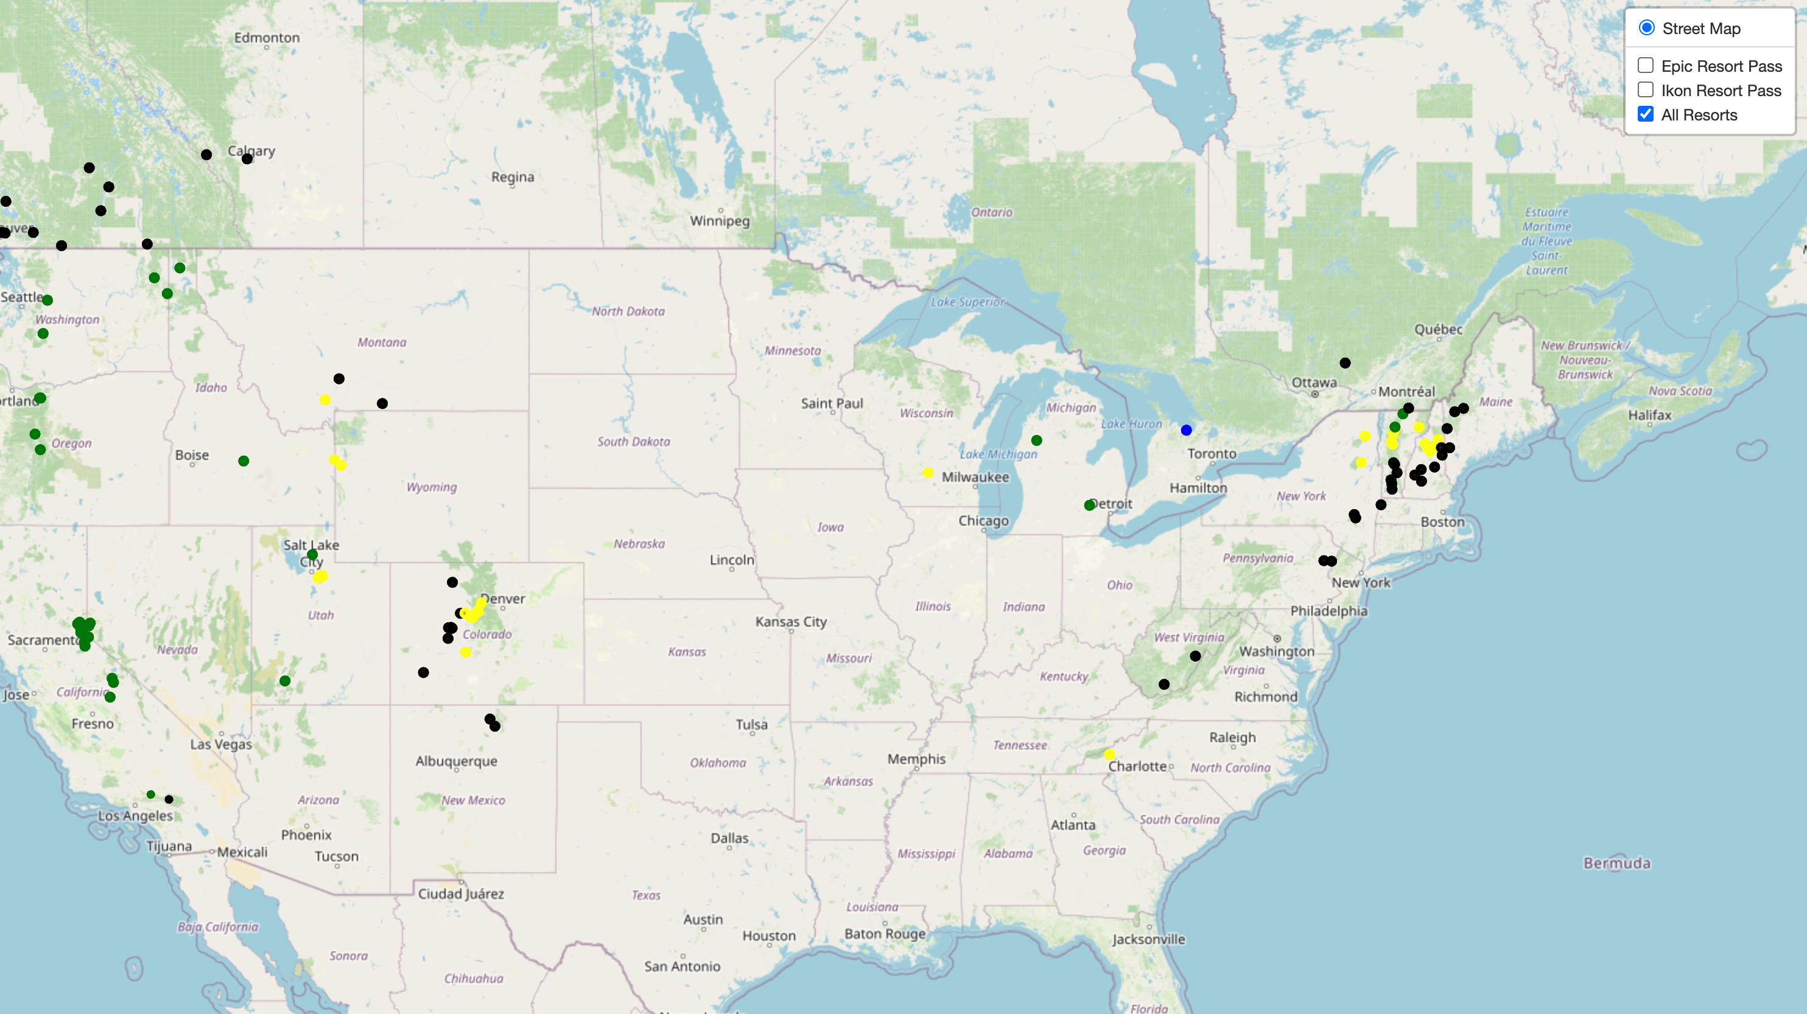
Demo

Slide 8

Questions?

